Slide 1

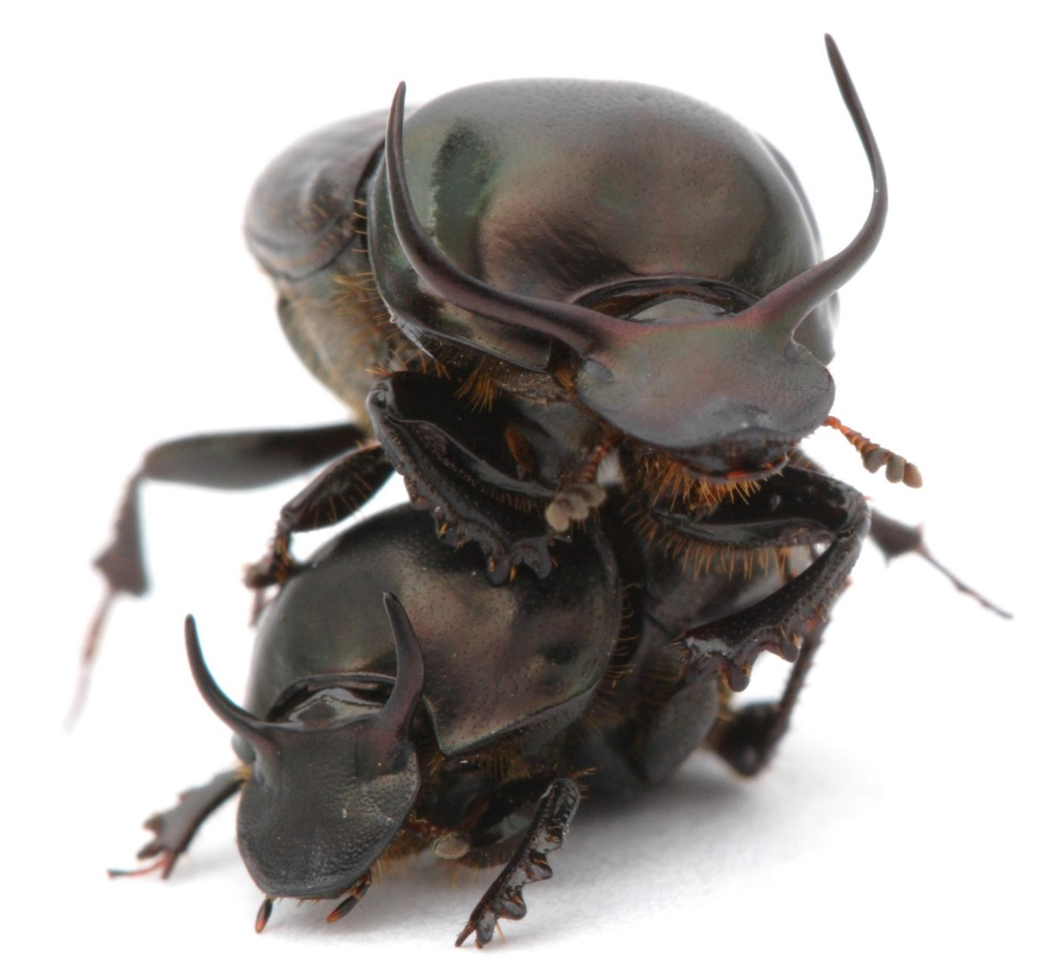
Weighted Gene Co-Expression Network Analysis of transcriptomes of the bull-headed dung beetle (Onthophagus taurus) across sex, instars and populations
I519 Class project presentation
Dec. 9th 2015
Samuel Durham, Anirudh Kamalapuram Muralidhar, Guillaume Dury
© Alex Wild

Slide 2
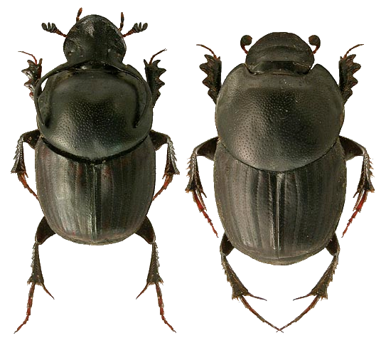
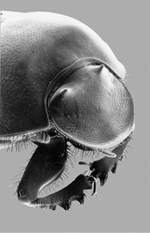
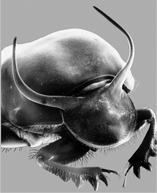
The bull-headed dung beetle (Onthophagus taurus)
© Lech Borowiec
© Stern & Emlen 1999

Slide 3
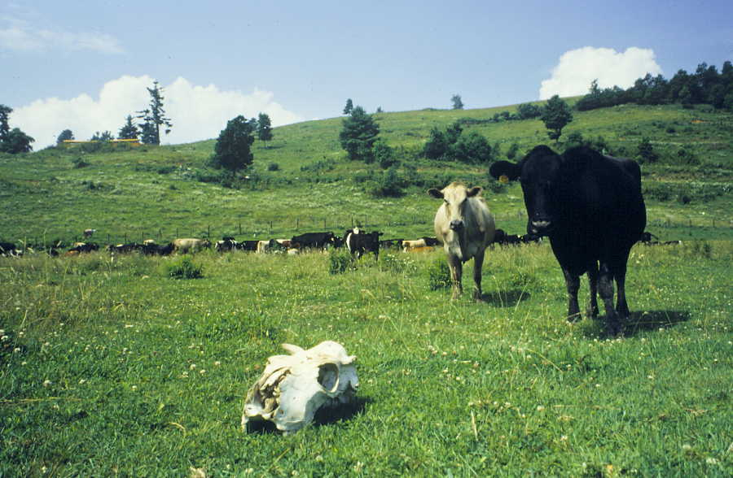
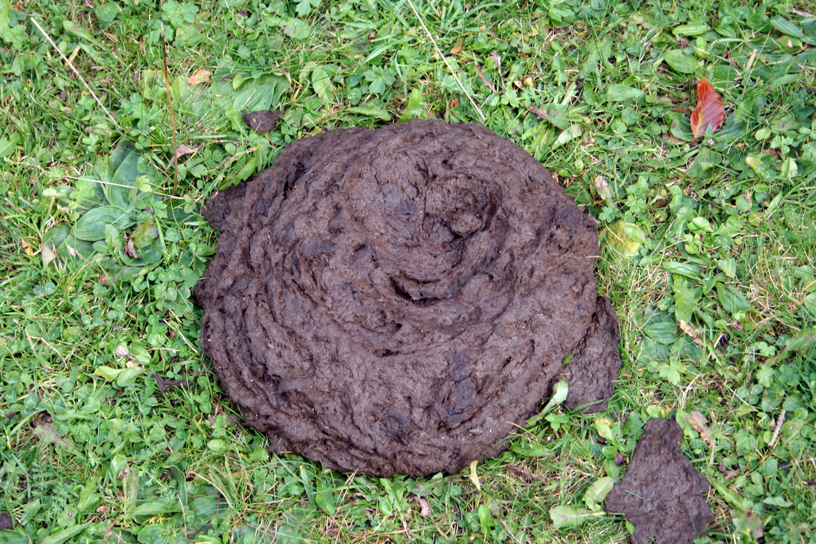
The bull-headed dung beetle (Onthophagus taurus)
© Laurent KB

Slide 4
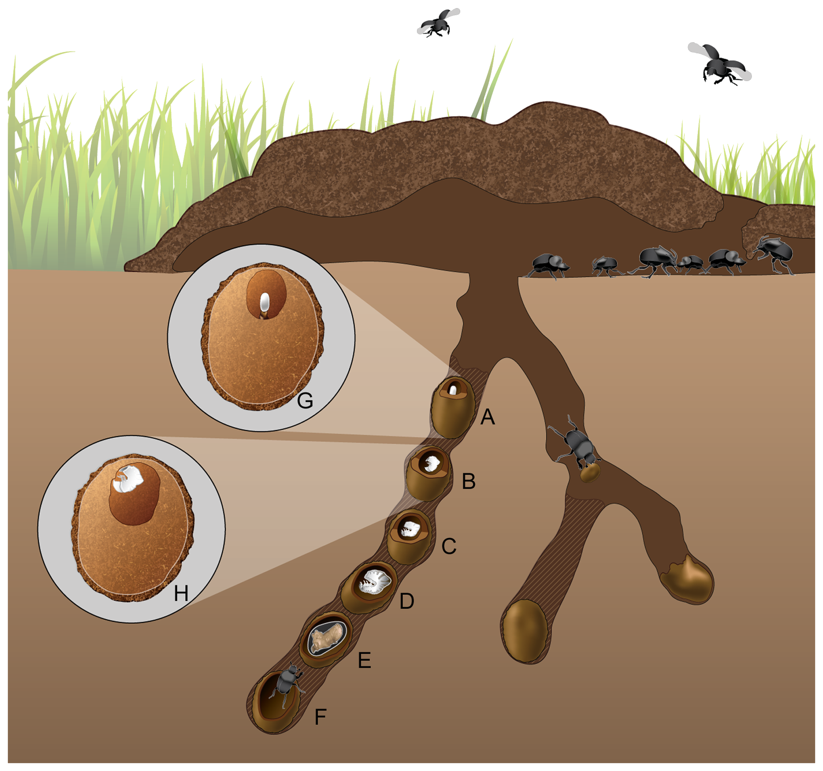
The bull-headed dung beetle (Onthophagus taurus)
Egg
Larval instar 1
Larval instar 2
Larval instar 3
Pre-pupa
Pupa
Adult
CC BY Estes et al. 2013

Slide 5
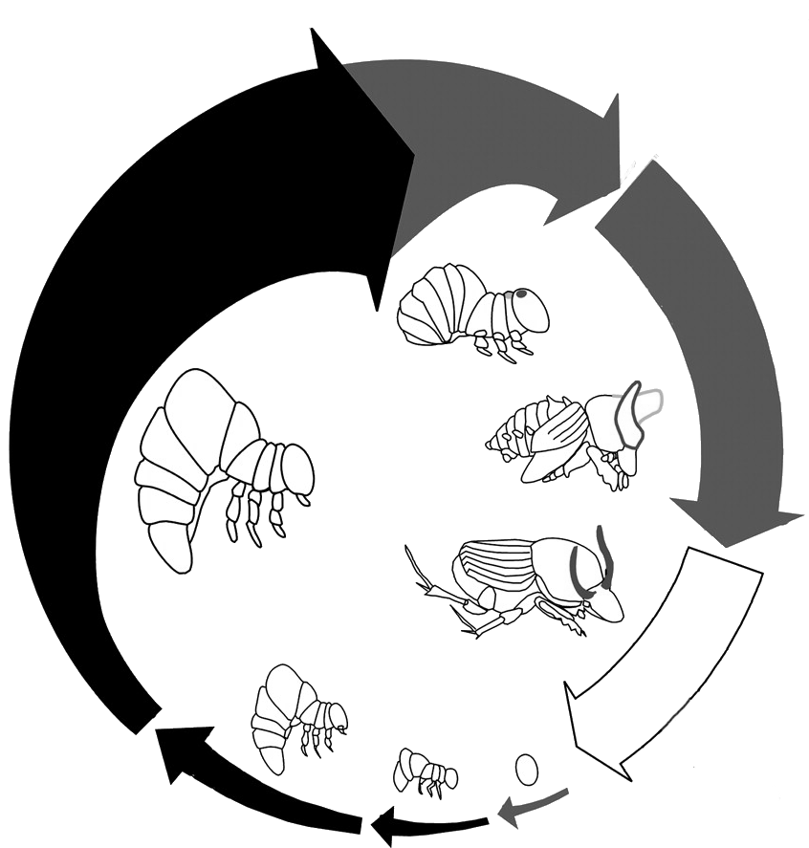
The bull-headed dung beetle (Onthophagus taurus)
Egg
Larval instar 1
Larval instar 2
Larval instar 3
Pre-pupa
Pupa
Adult
Adapted from Emlen et al. 2007

Slide 6
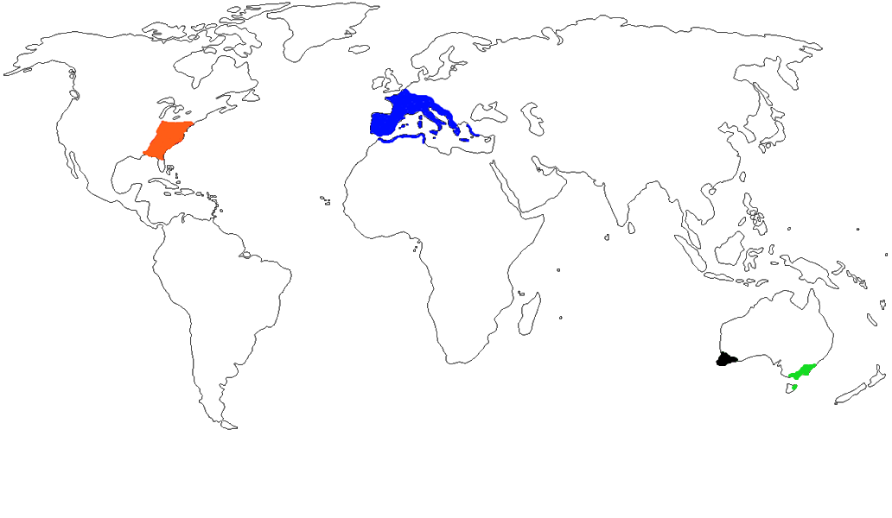
The bull-headed dung beetle (Onthophagus taurus)
Native
Exotic
Exotic
© Daniel Schwab

Slide 7
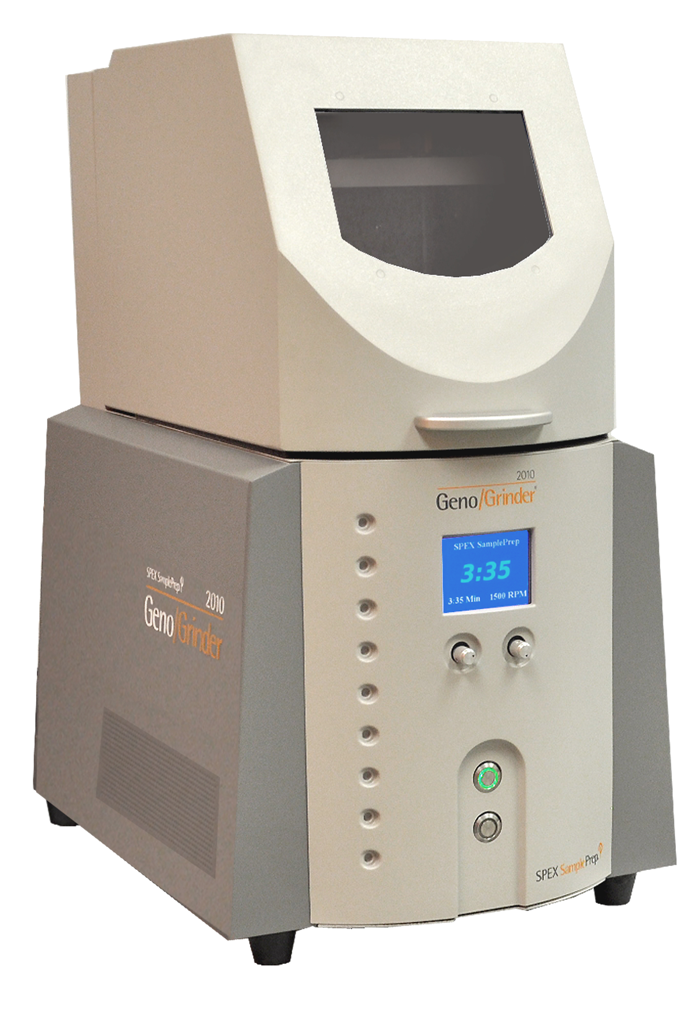
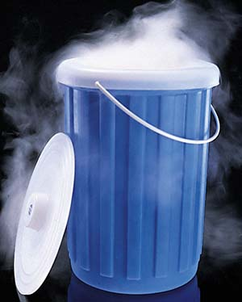
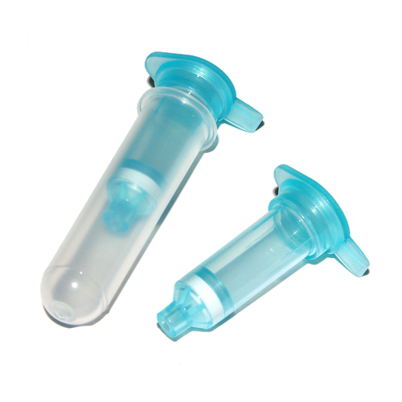
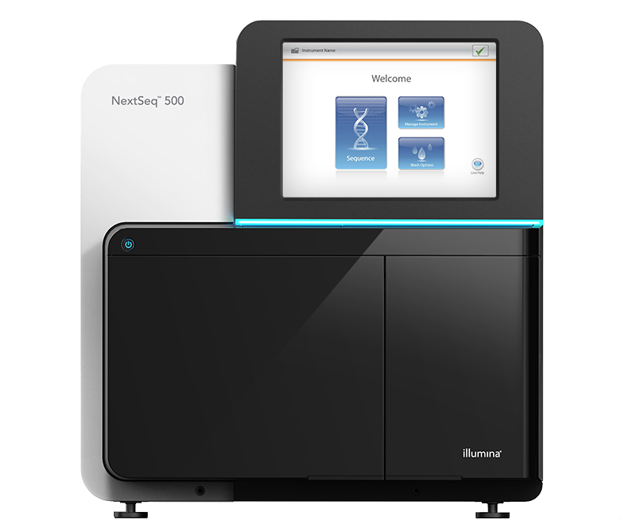
Transcriptomes
Whole body frozen in liquid nitrogen
Homogenized in Geno/Grinder tissue homogenizer
RNA was extracted using RNeasy Mini spin columns
High-throughput sequencing to get RNA-seq data
© vitascientific
© Thermo Scientific
Geno/Grinder®
© Illumina

Slide 8
Weighted Gene Co-Expression Network Analysis
Mapping of reads to Onthophagus taurus reference genome and reference transcriptome
TopHat (uses Bowtie2), trimmed *.fastq files / python script
Read count
With HTSeq-count (python based) / bash script
Runs on 32bit systems
Read normalization
With DESeq in R?
With edgeR in R.
Network analysis
With WGCNA package in R

Slide 9
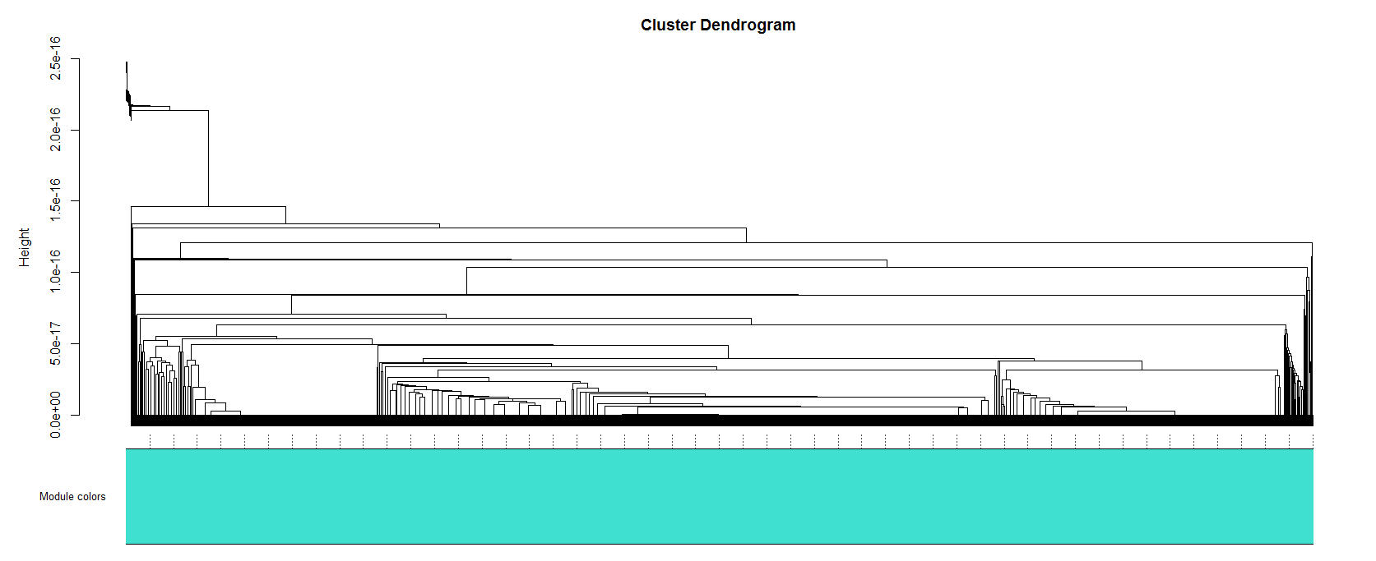
Issues: WGCNA after DESeq processing

Slide 10
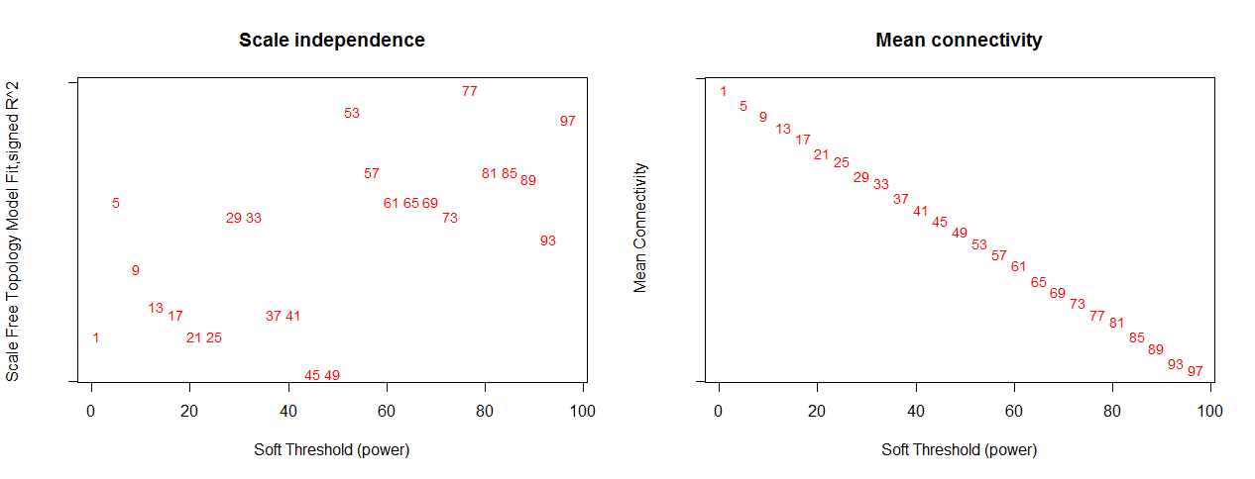
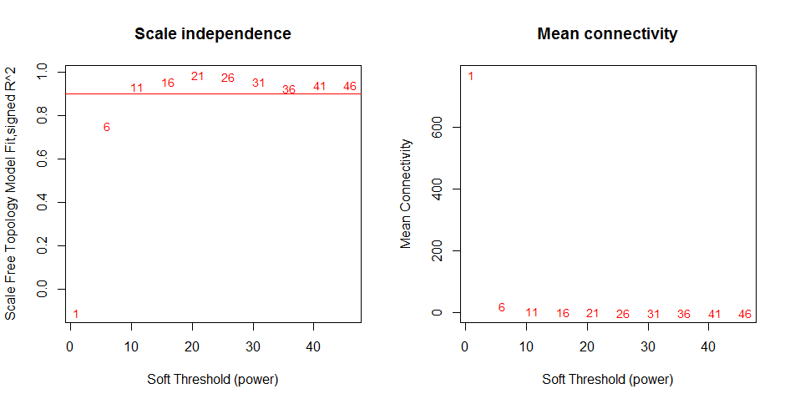
Issues: WGCNA after DESeq processing
Our data
Tutorial

Slide 11
Normalization in EdgeR
EdgeR
Filters out lowly expressed genes. No use comparing genes that are not expressed.
Cut-off is 2 counts per each million mapped reads.
TMM normalization.
Trimmed Mean of M-values; eliminates composition biases between libraries.

Slide 12
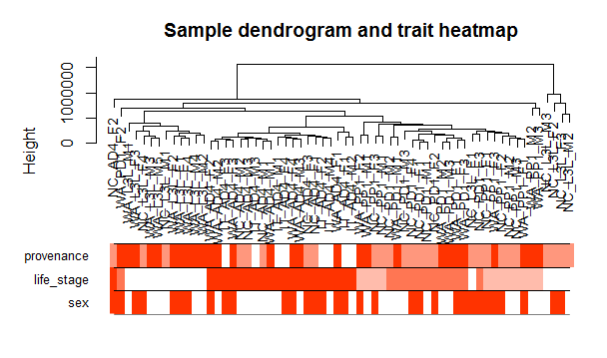
Weighted Gene Co-Expression Network Analysis

Slide 13
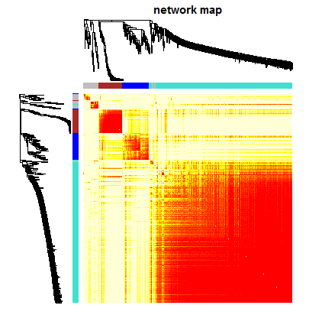
Weighted Gene Co-Expression Network Analysis

Slide 14
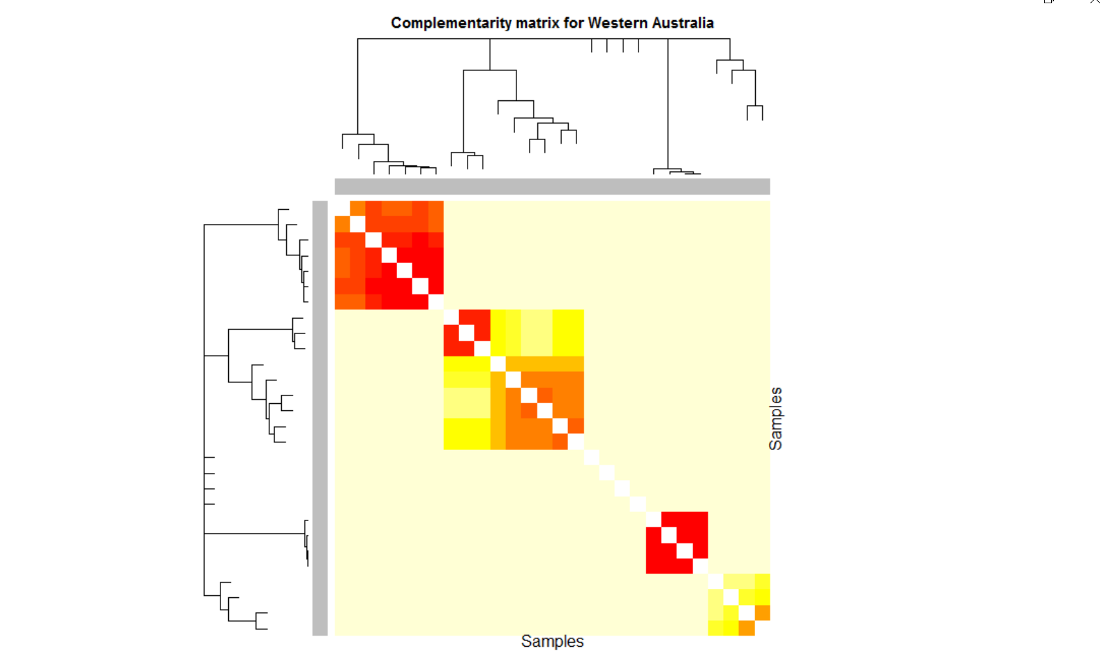
Weighted Gene Co-Expression Network Analysis
Here show WGCNA complementarity matrix for samples
♂
Adults
♀
♂
♂
♀
♀
♀
♀
♂
Larvae
♂
♀
♂
♀
♀
♂
♂
Pre-pupae
♂
♂
Pupae
♀
♂
Pupae
♀
♂
♀
♂
♀
Pre-pupae
♀
♀
♂

Slide 15
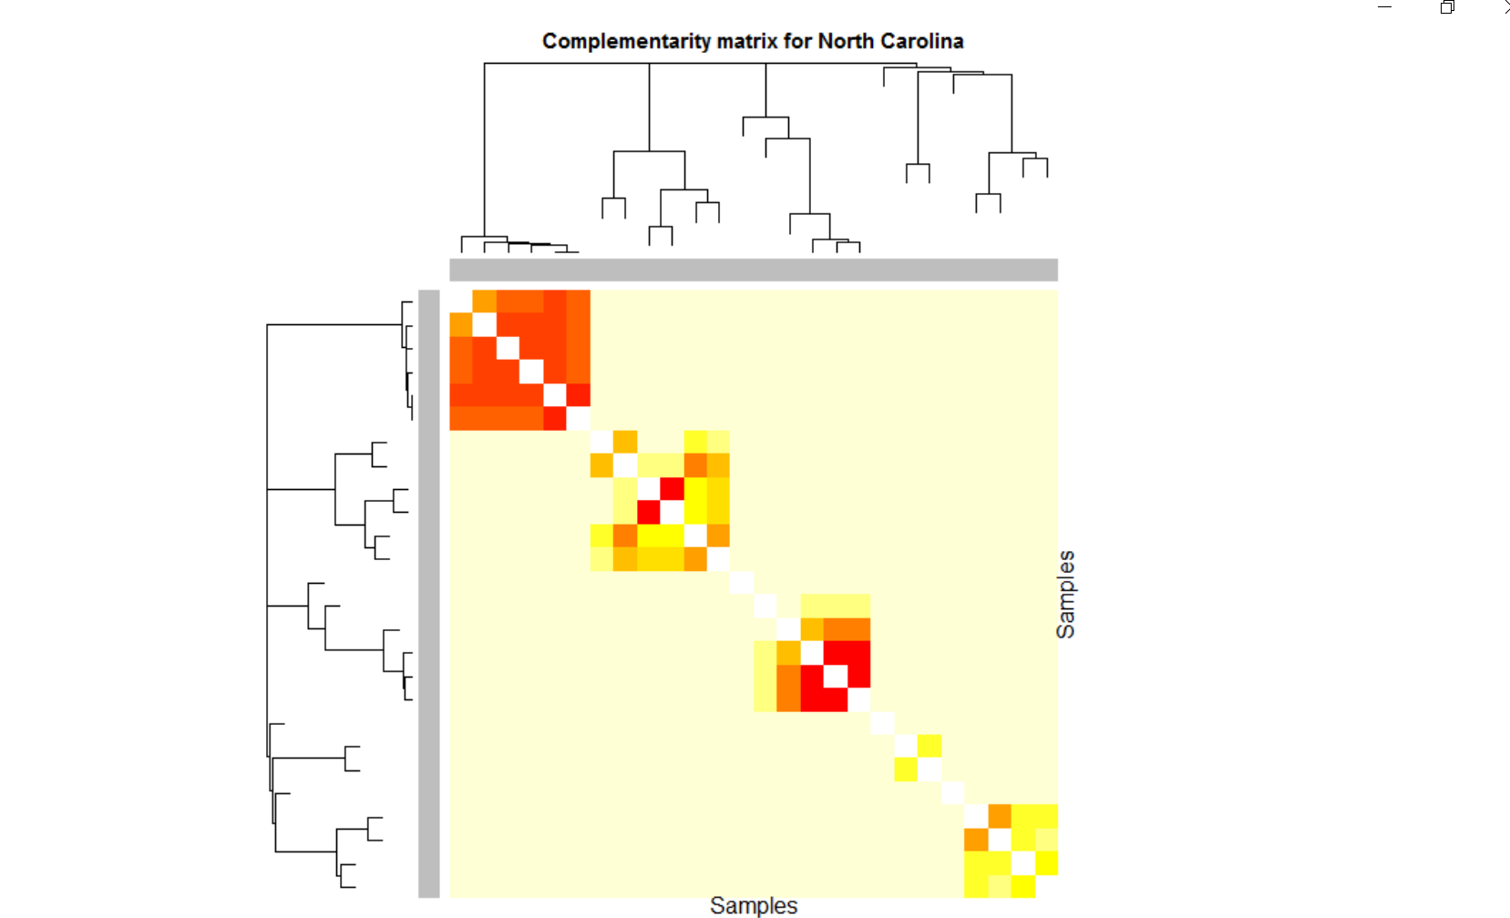
Weighted Gene Co-Expression Network Analysis
♀
Adults
♂
♂
♂
♀
♀
♂
♂
Larvae
♀
♀
♀
♂
Pupae
♂
♂
♀
♂
♀
Pupa
♀
♀
Pre-pupae
♀
Larva
♂
♀
♀
Pre-pupae
♂
♀
♂

Slide 16
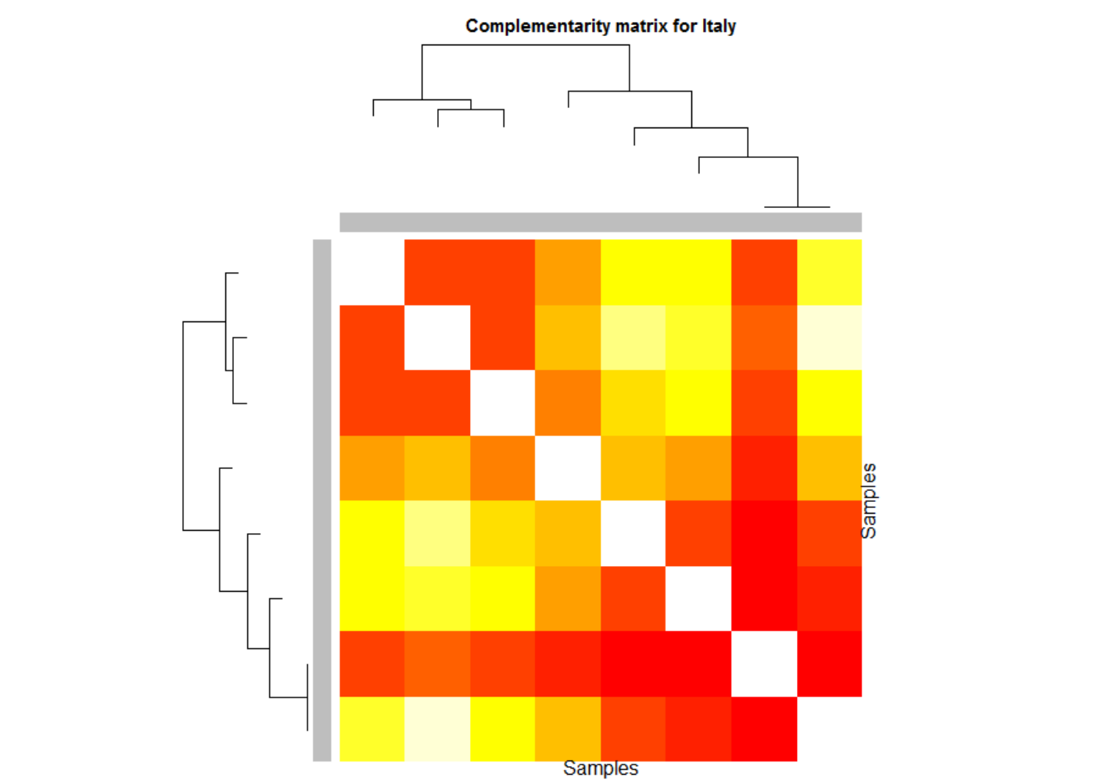
Weighted Gene Co-Expression Network Analysis
All adults
♂
♀
♂
♂
♂
♀
♀
♀

Slide 17
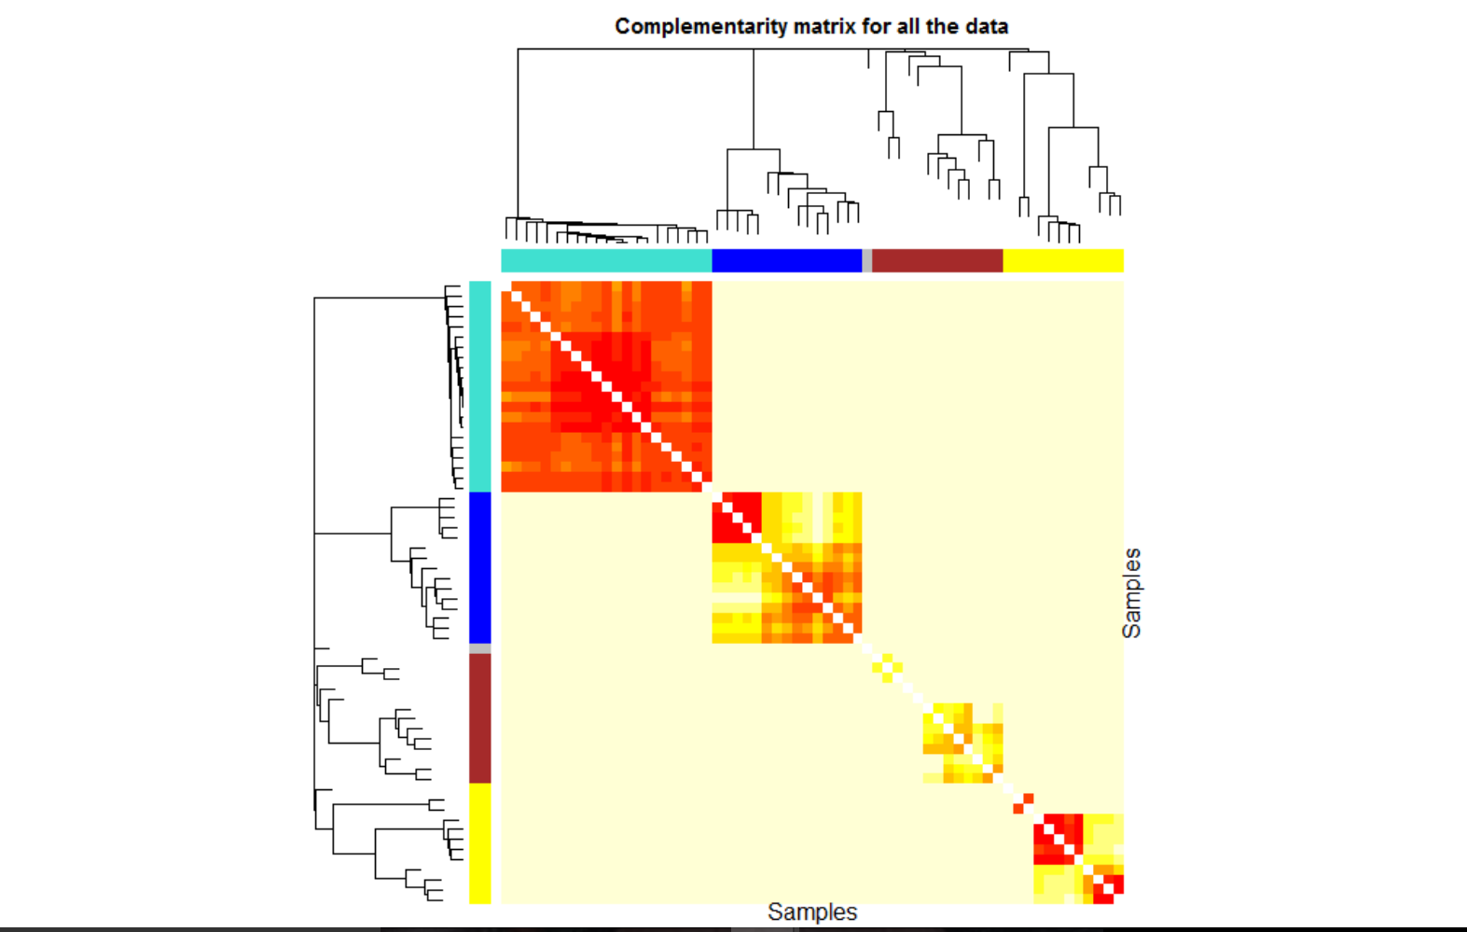
Weighted Gene Co-Expression Network Analysis
Adults
Larvae
Pre-pupa
Larva
Pre-pupae
Pupae

Slide 18
Conclusions
Many genes have similar expression profiles.
Samples cluster by life stage.
Populations are not very different.
Adults
Larvae
Pre-pupae
Pupae

Slide 19
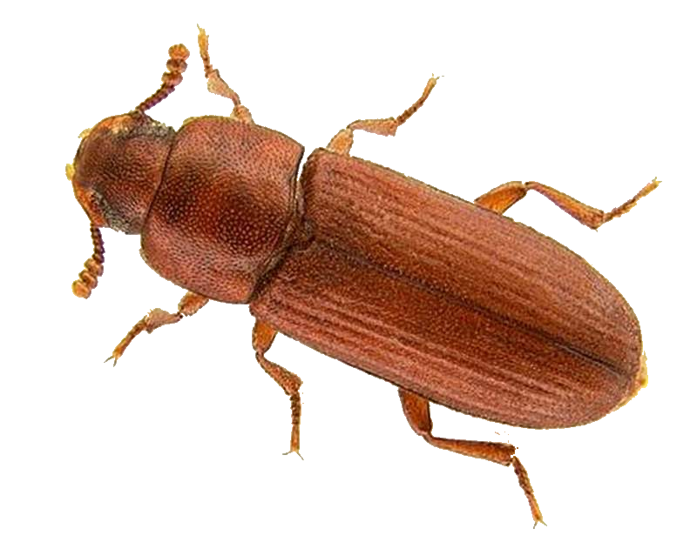
Future directions
Study the differences specifically
Link the modules to information on their function(s)
Blast genes of interest & link
Make other comparisons:
By tissue or body part
Integrate trait data
For males, horns or not
Size
By condition
High nutrition
Low nutrition
© Stern & Emlen 1999
USDA

Slide 20
Questions?
© Alex Wild

